Slide 1

SENG2260 Human-Computer Interaction
Workshop 8
Week 8
SPS

Slide 2
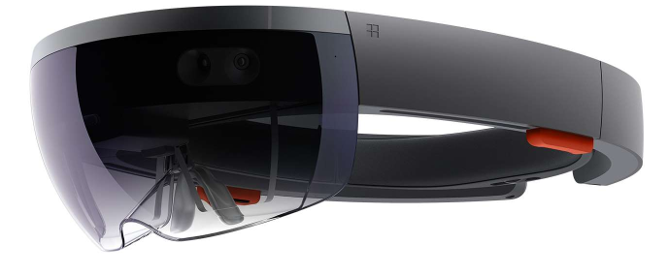
Today
AR technology and HoloLens

Slide 3
Augmented and Mixed Reality interaction
“Holograms are the next evolution in computing. With this vision in mind, hardware, software, and design came together to create the first fully self-contained holographic computer”
“Microsoft HoloLens is made up of specialized components that together enable holographic computing. The optical system that works in lock-step with advanced sensors. The HPU that makes light work of processing a large amount of data per second. All those components and more enable you to move freely and interact with holograms.”
https://www.microsoft.com/en-us/hololens/hardware
Today we will consider the use of the HoloLens head mounted display (HMD).

Slide 4
The Hololens and Mixed reality
Hololens overview
Video: https://www.microsoft.com/en-us/hololens
Mixed-realty: Remote assist
Video: https://dynamics.microsoft.com/en-us/mixed-reality/remote-assist/ (https://youtu.be/V732PXZHLiU)
Mixed-realty: Layout
Video: https://dynamics.microsoft.com/en-us/mixed-reality/layout/ (https://youtu.be/9viR6U-D2Co)

Slide 5

AR to change interaction
Augmented and Mixed Reality technology provides opportunities to re-envision interaction from more traditional user interfaces.
In this exercise you will consider how you could translate the information/material presented in the UON website to the AR world of the Hololens

Slide 6
UON website in AR
In groups (20 minutes), consider how the information in the UON website could be presented in the Hololens
How will different user interaction support access to the website content
How will Hololens use on campus change how information is presented
Class review (15 minutes): present your design vision / challenges / opportunities to the rest of the class

Slide 7
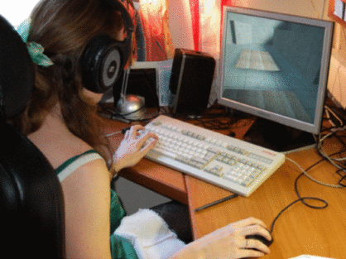
Next week
RLT: Gamer bias in evaluation studies
Before the workshop, read:
S. P. Smith and S. Du'Mont. Measuring the effect of gaming experience on virtual environment navigation tasks, IEEE 3D User Interfaces 2009 (3DUI 09), pg 3-10, IEEE, 2009.
http://dx.doi.org/10.1109/3DUI.2009.4811198

